Slide 1
Summary Prepared by Kris Damhorst, Chair Santa Cruz County Commission on the Environment
October 27, 2025

Slide 2
Battery Energy Storage Informational Workshop Series
The Santa Cruz County Commission on the Environment hosted three battery energy storage informational workshops this past summer, in June, July and August
June 25th
Dr. Mark Jacobson from Stanford, climate scientist with 30 years experience
Dennis Dyc-O’Neal, power grid and supply subject matter expert with 25 years experience
July 30th
Scott Murtishaw, battery storage expert with 20 years experience
Mike Nicholas, retired fire captain and battery safety consultant
August 20th
Lookout article from Matthew Pais, retired fire captain and battery safety consultant and expert

Slide 3

What are the primary motivations for a rapid global transition to 100% Wind, Water, and Solar (WWS) energy?
Fossil fuels kill 7.4 million people through air pollution annually worldwide, costing an estimated $30 trillion per year
Global warming is projected to cost a similar amount by 2050
The increasing scarcity of fossil fuels will lead to higher energy prices and contribute to economic, political, and social instability

Slide 4
Why is battery storage crucial for achieving California's renewable energy goals?
Battery storage is essential because:
Renewable energy sources like solar and wind are intermittent; solar generates electricity when the sun shines, and wind power when the wind blows, but not consistently.
Batteries balance these intermittent renewables by storing excess energy generated during peak production times (e.g., midday for solar) and dispatching it during high-demand, low-generation periods (e.g., evening hours).
This significantly enhances community resilience from outages that would affect medical equipment, heat and air conditioning, carbon monoxide poisoning.
Battery energy storage helps stabilize the grid, reduces reliance on expensive and polluting combustion-based generation (peaker plants), and captures curtailed (wasted) solar energy, which would otherwise be lost.

Slide 5
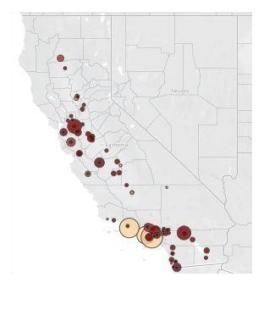
Where are these “peaker plants” located in our community?
Gilroy Energy Center in Gilroy
Metcalf Energy Center south of San Jose
Tracy Peaker Plant near Tracy

Slide 6
For California to meet its 100% renewable goal by 2045
It is estimated that 52,000 megawatts of battery storage will be needed.
Without sufficient storage, the state cannot transition off fossil fuels affordably and achieve our climate goals

Slide 7
What is Battery Energy Storage System (BESS) and why is fire safety a critical concern?
BESS refers to systems that store electrical energy in batteries for later use.
Fire safety is a critical concern due to the potential for thermal runaway in batteries, which can lead to fires.
While BESS failure rates have significantly decreased (by 97% between 2018 and 2023) due to improved codes and manufacturing, the inherent risks necessitate rigorous safety measures.

Slide 8
Key battery safety design changes include:
Internally cooled systems
Separate fire suppression within battery containers
The ability to derate individual modules to prevent thermal runaway
Increased spacing between outdoor battery modules (from 18 inches to 6.5-10.5 feet, with some new facilities opting for 28 feet)
The industry has also largely shifted to more stable lithium iron phosphate batteries.

Slide 9
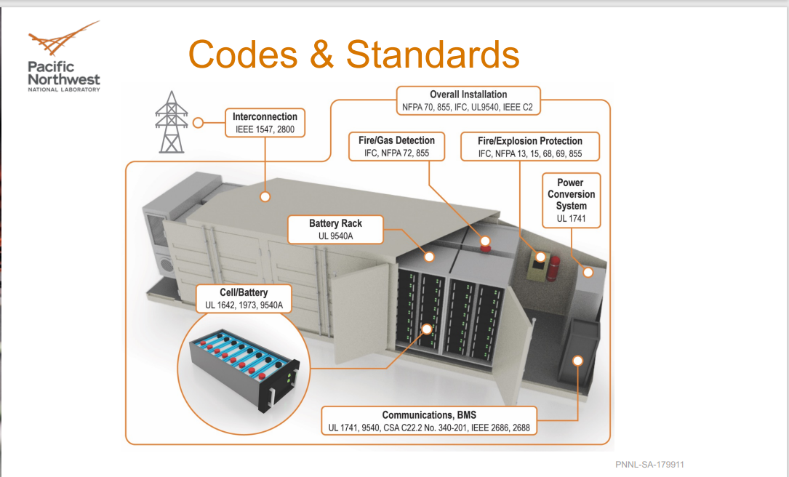

Slide 10
What are the key safety standards and codes that govern BESS installations?
Several key safety standards and codes govern BESS installations to ensure safety and prevent hazards:
UL 9540: Covers integrated systems, battery management systems, inverters, and interconnection equipment.
UL 9540A: A standard test method for evaluating thermal runaway fire propagation in BESS at cell, module, and unit levels.
NFPA 855: Provides guidelines for the installation of stationary energy storage systems, including proper setbacks to prevent fire propagation.
NFPA 69: Focuses on explosion prevention systems, often involving hydrogen sensors and active ventilation.
NFPA 72: The National Fire Alarm and Signaling Code, which dictates fire alarm system design and monitoring.
SB 283 (Sen. John Laird): Battery storage developers will be required to engage with local fire authorities prior to submitting an application. This consultation must address facility design, assess potential risks, and integrate emergency response plans, such as those required under SB 38 – Just signed into law

Slide 11
Why do lithium-ion batteries currently dominate the energy storage market?
Lithium-ion batteries currently dominate the energy storage market primarily due to significant advancements in their performance and durability
Coupled with a dramatic 90% decline in costs between 2010 and 2023. This cost reduction was driven by massive investment and economies of scale fueled by demand from consumer goods, battery energy storage systems (BESS), and electric vehicles (EVs).
They boast high round-trip efficiency (85%-90%), excellent energy density, improved durability, and fast response times

Slide 12
Lithium vs Sodium Batteries
Energy Density Is Lower
Sodium ions are larger and heavier than lithium ions, which limits how much energy can be stored per unit of weight or volume.
For big stationary systems, weight isn’t as critical, but lower density means larger installations and higher balance-of-plant costs (land, housing, cabling, cooling).
Commercial Maturity & Supply Chain
Lithium-ion has a 25+ year head start in research, manufacturing, and deployment.
Gigafactories, supply chains, and financing models are already optimized for lithium.
Sodium-ion is still in the pilot/demo/intro stage; banks and utilities are hesitant to finance unproven technology at scale.
Cycle Life & Performance
Sodium-ion batteries today generally have shorter cycle lives than lithium iron phosphate (LFP) cells, though this is improving.
They also typically have slower charge/discharge rates, limiting their usefulness in fast-response grid services.
Cost Competitiveness (So Far)
Sodium is far more abundant and cheaper than lithium, but the manufacturing process isn’t yet scaled.
Until sodium-ion production reaches high volumes, lithium-ion still wins on $ per kWh installed in most projects.
Bankability & Standards
Utilities and developers need technologies that are certified, insurable, and financeable.
Lithium-ion has a long track record (safety standards, warranties, field data).
Sodium-ion lacks that level of trust in long-term reliability at the moment.

Slide 13
Based on our battery energy storage workshops we recommended the following
The Commission on the Environment found that Battery Energy Storage Systems are essential infrastructure for meeting Santa Cruz County’s 2022 Climate Action and Adaptation Plan
Policymakers should prioritize BESS as a cross-cutting solution that delivers on emissions reduction, environmental resilience, lower energy costs, and grid scale stability.
Based on additional learning of BESS implementation in the state, public comment, and potential policy implications we urge the Board to act now to ensure Santa Cruz County retains land use authority for BESS technologies that incorporate the highest standards for public and firefighter safety, and ecosystem integrity

Slide 14
Commission on the Environment Recommendation Highlights
Alignment with Codes and Standards
Safety, Emergency Response, and Monitoring
Facility Infrastructure Requirements
Fire Detection and Suppression Best Practices
Training and Drills
Environmental Impact Assessment (EIA) and Ongoing Monitoring
Adaptive Technology Updates
Resident Accommodations / Liability / Public Engagement
Grid Resilience & Strategic Deployment

Slide 15
Thank you!

